Slide 1
Embedded Software Engineering Exercise - 01
Shreya Manasali

Slide 2
Home Automation
Home automation is a method of controlling home appliances automatically for the convenience of users. This technology makes life easier for the user, and saves energy by utilizing devices according to strict requirements.
Controls can be as basic as dimming lights with a remote or as complex as setting up a network of items in the home that can be programmed using a main controller or even via cell phone from anywhere in the world.

Slide 3
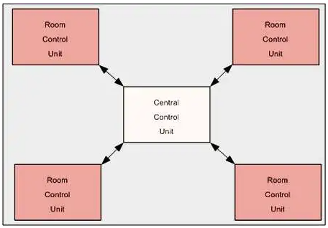
Architecture
Some home automation systems utilize the star topology architecture. The Central Control Unit is the hub and brain of a home automation system. A Room Control Unit controls the appliances in a particular room.
It has a set of sensors to sense the surrounding environment. Based on the current conditions, it can decide upon a course of action.
Source: https://www.embedded.com/home-automation-system-design-the-basics/
https://ieeexplore.ieee.org/document/6808026?arnumber=6808026

Slide 4
Characteristics
Reactive System: The central control unit controls the appliances based on time, such as automatically switching OFF a television at a specific time. It also informs remote users when an intrusion is detected or when some fault is detected in the system.
Real-time System: Central control unit measures the current environmental conditions using the various sensors and control the lights and fans of the rooms accordingly. It also monitors the current state of power and switch off appliances to protect them when a power fault is detected. Room control unit monitors the current environmental conditions using the various sensors and communicate this data to the Central control unit.
Continuous/Discrete System: Live telemetry data produced by sensors and devices might be continuous or discrete. Central control unit makes this data available for users to have insights.
Dependable System: Central control unit depends on GSM or Ethernet for receiving instructions from a remote user and controlling an appliance in a specific room as per the received instructions. Room control unit controls appliances based on inputs from a hand held remote also based on inputs from user buttons.
Distributed System: Central and Room control units have their own controllers to perform their respective tasks. Room control unit receives instructions from central control unit and controls the appliances in the room as per the received instructions.

Slide 5
Thank You

